Slide 1
Multimodal Prompting
Generative AI
Module 1 – Lesson 5
Notes:
Multimodal applications combine and process information from multiple modalities like text, images, audio, and video to enable more natural and intuitive interactions. These applications leverage multimodal models that can understand and generate data across different modalities simultaneously.

Slide 2
Today’s activities
Introduction to multimodal applications
Multimodal LLMs
Prompting MLLMs
Multimodal use cases
Notes:
Let's begin by introducing multimodal applications, which combine and process information from various modalities like text, images, audio, and video. Next, we'll discuss multimodal language models (LLMs), which are models trained on data from multiple modalities, allowing them to process and generate content across different modalities coherently. Finally, we'll cover prompting techniques for multimodal LLMs, which involve providing the model with appropriate inputs from multiple modalities to generate desired outputs, such as generating image captions from both text and visual inputs. Finally, we'll explore some common use cases where multimodal applications can be beneficial, highlighting real-world scenarios and potential applications.

Slide 3
Introduction to multimodal applications
Notes:
Let's discuss the key concepts about multimodal applications.

Slide 4
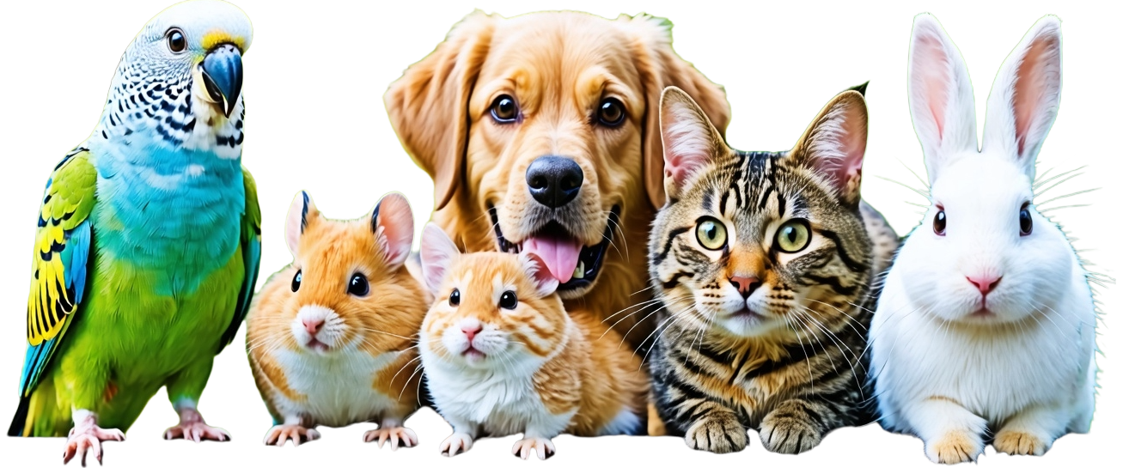
Your marketing company has been hired by a pet shop:
They need to create individual flyers about each pet based on their images and bio
How can you do that with traditional, single modality models?
Notes:
Let's take an example to introduce multimodality. Your marketing company has been hired by a pet shop to create individual flyers for each pet, combining their images and information. Let's examine how this task can be accomplished using single modality models.
Image: AI Generated using Nova Canvas (AWS Bedrock)

Slide 5
We can consider an image-only model
Learns information only from images
Computer vision (CV)
Can accomplish basic image understanding tasks
Classifying images for our campaigns depending on the theme needed
Ex. Cat class, dog class
Object detection
Semantic segmentation
It won’t accept the input search query or won’t be able to generate text
CV
model
Object Detection
Bird
Dog
Hamster
Hamster
Cat
Rabbit
Notes:
Let's consider an image-only model that operates within the field of computer vision. These models learn and extract information solely from visual data like images. They can handle basic image understanding tasks such as classifying images into specific categories based on the desired theme, for instance, identifying images containing cats or dogs. Additionally, certain models are capable of object detection, pinpointing and localizing particular objects within an image, or tasks like semantic segmentation, which involves labeling different regions of an image with semantic meanings. However, image-only models have inherent limitations - they cannot process input text queries or generate textual outputs. Their capabilities are restricted to analyzing visual information, making them inadequate for tasks requiring integration and reasoning across multiple modalities like text and images together.
Image: AI Generated using Nova Canvas (AWS Bedrock)

Slide 6
We can consider a text-only model
Learns information only from text
Can accomplish basic text understanding tasks
Generating text based in a campaign description
Won’t be able to generate a description of the pets from images
There is a 2-year-old pomenerian looking…
Language model
for a loving home …
Notes:
We can also consider a text-only language model, which learns information solely from textual data. Such models can accomplish basic text understanding tasks like generating text based on a campaign description. However, they will not be able to generate descriptions of pets from images, as they cannot process visual information. Text-only models are suitable for applications that involve processing and generating natural language, but they have limitations when it comes to tasks that require understanding and reasoning over multimodal data like images and text together.

Slide 7
What does “multimodal” mean?
Humans are naturally multimodal in the way we interact with the world!
Perceive the world using multiple senses:
Vision, hearing, smell, taste and touch
Engage in non-verbal communication
Gestures
Facial expressions
Body language
Eye contact
Appearance
Notes:
Humans are naturally multimodal in the way we interact with the world. We perceive the world using multiple senses - vision, hearing, smell, taste, and touch. We also engage in non-verbal communication through various channels like gestures, facial expressions, body language, paralinguistics (vocal cues like tone, pitch, volume), appearance, eye contact, and artifacts or objects around us. This multimodal nature of human perception and communication is an integral part of how we experience and make sense of the world.

Slide 8
Why multimodal?
Generative AI shifted from prediction to interaction
Multimodality is a way to boost AI performance to interact with humans to solve real world problems
Notes:
Generative AI has undergone a significant shift, transitioning from primarily focusing on prediction tasks to emphasizing interactive capabilities. This evolution highlights the growing importance of multimodality in enhancing AI performance when it comes to interacting with humans and solving real-world problems. The incorporation of multimodality enables AI systems to engage with humans more intuitively and effectively. It facilitates seamless interactions by allowing AI to comprehend and respond to human behavior and communication in a comprehensive way. Ultimately, this capability enhances AI's ability to solve real-world problems that require a deep understanding of human interactions and contexts.

Slide 9
Data modalities
Image Data:
The most versatile format for model inputs
There’s much more visual data than text data
Phones and webcams constantly take pictures and videos today
It can be used to represent:
Text
Tabular data
Audio
And to some extent, videos
Notes:
Image data is considered the most versatile format for model inputs in AI systems. This is because there is a vast amount of visual data available, surpassing the quantity of text data or other types of data. Modern devices like smartphones and webcams are constantly capturing pictures and videos, generating a wealth of visual information. Image data can represent various types of information beyond just visual content. It can encode text, tabular data, audio, and even videos to some extent. This versatility allows AI models to process and understand different forms of data through image inputs, enabling them to tackle a wide range of real-world problems and applications across diverse domains.

Slide 10
Data modalities
Text Data:
Text is a powerful mode for model outputs
A model that can understand/generate text can be used for many tasks:
Summarization
Translation
Reasoning
question answering
etc.
Notes:
Text data is another powerful modality for model outputs. A model that can understand and generate text can be utilized for various tasks like summarization, translation, reasoning, question answering, and more. Text is a versatile mode that allows models to tackle a wide range of applications by processing and generating natural language. The ability to comprehend and produce human-readable text makes this modality highly valuable for developing intelligent systems that can communicate and interact with humans effectively.

Slide 11
Other data modalities
Video
Audio
Haptic data
Electrical signals
In this course, we will focus mainly on text and image data.
Notes:
Other data modalities that can be used in machine learning models include video, audio, haptic data, and electrical signals. While this course will primarily focus on text and image data, these other modalities open up possibilities for models to process and generate different types of data beyond just text and images.

Slide 12
Multimodal LLMs
Notes:
Let's discuss multimodal LLMs. These models can process and/or generate data across different modalities like text, images, audio, and video. By combining multiple data types, multimodal LLMs can understand and communicate more like humans, enabling richer interactions and applications.

Slide 13
Review: Large Language Models (LLMs)
Foundation models trained on text
Large ML models that learn the probabilities of words being used in certain contexts
Training task: Learn to predict the missing word in a text sequence
Foundation models
Large Language Models (LLMs)
“The weather has been cloudy for the last two days. Most likely it will be ____ tomorrow.”
cloudy?
sunny?
foggy?
….
Notes:
Let's revisit our discussion on LLMs from previous lessons. Large language models (LLMs) are foundation models trained on text data to learn word probabilities in different contexts. The training task involves predicting missing words in sequences, enabling LLMs to develop a deep language understanding. By fine-tuning or prompting, LLMs become highly versatile for various natural language processing applications.

Slide 14
Multimodal LLMs (MLLMs)
Large language models trained on multiple modalities
MLLMs typically use encoders and adapters to Equip LLMs with cross modal capabilities
Vision encoder
Video encoder
Audio encoder
Foundation models
LLMs
Multimodal LLMs
Notes:
Multimodal LLMs, or MLLMs, are large language models adapted for multiple modalities, such as text, images, video, and audio. Unlike traditional LLMs that focus solely on text, MLLMs can process and generate content across various data types. To equip LLMs with cross-modal capabilities, MLLMs typically employ encoders and adapters specifically designed for different modalities. For instance, a vision encoder allows the model to understand image-related content, while a video encoder enables it to process video data. By combining these modality-specific components with the core language model, MLLMs can understand and generate content that seamlessly integrates multiple data types, opening up new possibilities for multimodal applications and human-machine interactions.

Slide 15
Prompting MLLMs
Notes:
Let's discuss prompting MLLMs, which involves providing the appropriate inputs or prompts to these multimodal language models.

Slide 16
Prompting MLLMs
Text prompts:
Follow best prompting strategies discussed in previous lessons
Image prompts:
Input format: Most MLLMs use base64-encoded format
Image size: Adhere to the image size limitations (e.g. <5MB)
Multiple images: Most MLLMs can only analyze a limited number of images
Image format: Follow the image format specified for the MLLM (e.g. jpg, png, etc.)
Image clarity: Avoid blurry images
Image placement: In most cases, it works better when images come before text
Image resolution: Be within the image resolution limits of the MLLM
Notes:
When prompting multimodal language models (MLLMs) with text inputs, it is recommended to follow the best prompting strategies discussed in previous lessons, such as providing clear and concise prompts, avoiding ambiguity, and ensuring the prompts align with the model's capabilities. For image prompts, most MLLMs require the images to be in base64-encoded format. It is crucial to adhere to the image size limitations imposed by the MLLM. Most MLLMs have a limited capacity for analyzing multiple images simultaneously, so it is essential to be mindful of the number of images provided in a single prompt. Exceeding the model's limit may result in incomplete or inaccurate analysis. The image format is another critical factor to consider. MLLMs often have specific requirements for the image format, such as JPG, PNG, or others. Providing images in an unsupported format may prevent the model from processing them correctly. Image clarity is also essential for accurate analysis. Blurry or low-quality images can lead to inaccurate results or misinterpretations by the MLLM. It is recommended to use clear, high-quality images whenever possible. For some cases, it has been observed that providing images before the text input can improve the model's performance and understanding. This order allows the MLLM to analyze the visual information first and then incorporate the textual context. Finally, it is crucial to ensure that the image resolution falls within the MLLM's specified limits. Images with resolutions that are too high or too low may not be processed correctly or could lead to suboptimal results. Please consult the model details for all the details.

Slide 17
Multimodal use cases
Notes:
Let's explore some common use cases for multimodal models that can process both text and visual data.

Slide 18
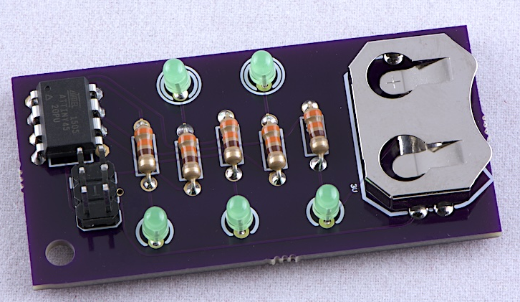
Visual question answering
Instead of relying only on text for the context, you can give the model both text and images
Examples:
Generate text descriptions of images
Query using both text and images
Image analysis using text prompts
What is the purpose of the highlighted part in the circuit board?
Notes:
Visual question answering is a technique that allows models to utilize both text and images as input, rather than relying solely on text for context. This approach enables more comprehensive understanding and analysis by combining textual information with visual cues from images. Examples of visual question answering include generating textual descriptions of images, querying information using a combination of text and images, and performing image analysis guided by text prompts. By integrating visual and textual data, models can provide more accurate and contextual responses to queries related to the given image.

Slide 19


Text-based image retrieval
Image search matters not only for search engines but also for enterprises to be able to search through all their internal images and documents
Examples:
Given a text query, find images whose captions/metadata are closest to this text query
Given a text query, find all images whose embeddings are closest to this embedding
Find chairs in stock
Can bring images with closest embeddings to the text
In-stock #: 235
In-stock #: 15
Using also image metadata
Notes:
Text-based image retrieval is another important application area. Image search is valuable not just for search engines, but also for enterprises to efficiently search through their internal image and document repositories. Two key examples of text-based image retrieval are: Given a text query, find images whose captions or metadata are closest to this text. Alternatively, given a text query, find all images whose embeddings or representations are closest to the embedding of this text. Text-based image retrieval has many practical use cases across e-commerce, media libraries, and enterprise document management by allowing users to search and surface relevant visual content using text queries or descriptions. Image 1: https://stock.adobe.com/search/images?filters%5Bcontent_type%3Aphoto%5D=1&filters%5Bcontent_type%3Aimage%5D=1&filters%5Bfetch_excluded_assets%5D=1&filters%5Binclude_stock_enterprise%5D=1&order=relevance&limit=100&search_page=1&search_type=visual-search-browse&acp=&aco=AI+assistant++animated&k=&native_visual_search=67225ea17aa8a&similar_content_id=&model_id=&serie_id=&find_similar_by=all&get_facets=1&asset_id=950690854
Image 2: https://stock.adobe.com/search/images?filters%5Bcontent_type%3Aphoto%5D=1&filters%5Bcontent_type%3Aimage%5D=1&filters%5Bfetch_excluded_assets%5D=1&filters%5Binclude_stock_enterprise%5D=1&order=relevance&limit=100&search_page=1&search_type=visual-search-browse&acp=&aco=AI+assistant++animated&k=&native_visual_search=67225ea17aa8a&similar_content_id=&model_id=&serie_id=&find_similar_by=all&get_facets=1&asset_id=950696801

Slide 20
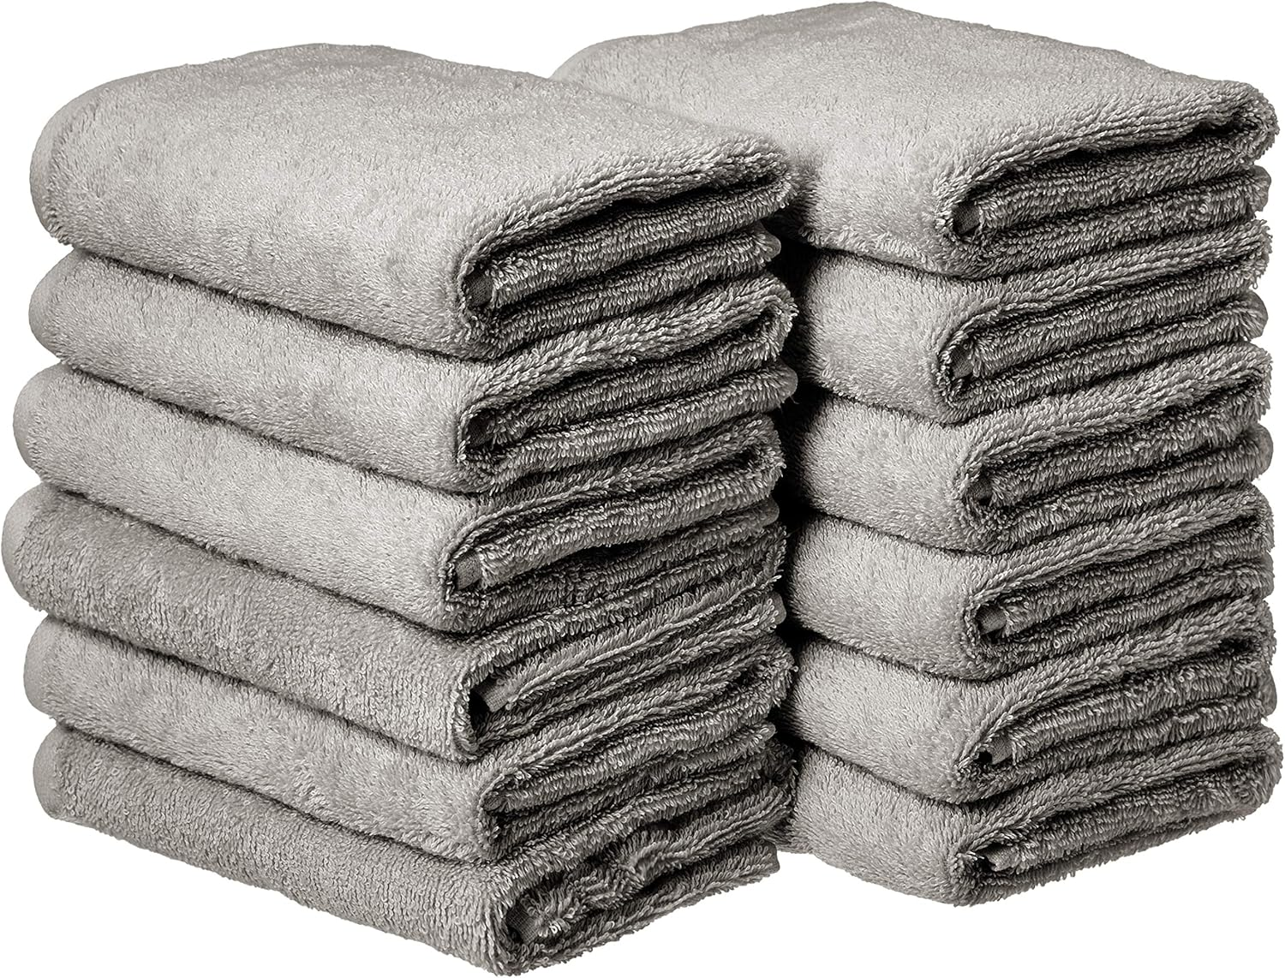


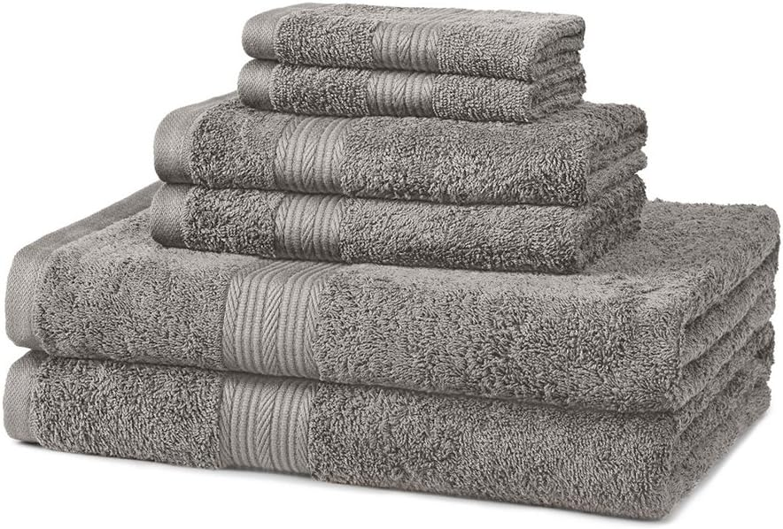
Deep image similarity retrieval
Given an image, find similar images
Examples:
Retrieving similar images for Amazon products
Identifying other product from the manufacturer
Notes:
Deep image similarity retrieval refers to finding visually similar images given an input image query. This has applications like retrieving similar product images for e-commerce sites or identifying other products from the same manufacturer. Deep learning techniques are employed to extract visual embeddings that capture the semantic similarities between images, enabling this retrieval capability across large image catalogs. Such visual search is valuable for enhancing user experiences on retail platforms by surfacing relevant product recommendations based on visual cues.

Slide 21

Next lesson
This lesson introduced multimodal models and applications
Notes:
This lesson introduced multimodal models and applications. In the next lesson, we will learn how to build and evaluate applications using LLMs.

